Slide 1

Document version: CURRENT
Document Owner: Paul Armstrong <parmstro@redhat.com>
Current Recommended Version: This document
Content Owner: The user responsible for each slide’s content is marked in the speaker notes
See: Contributors page
This document follows the ABCD Versioning Notation Lifecycle

Slide 2
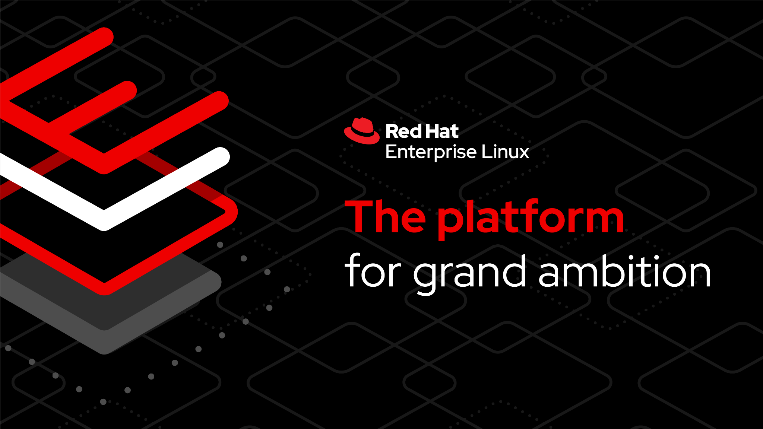

Slide 3
Red Hat
Infrastructure Standard
Adoption Model
Services Seller Enablement
Last Updated: 2026-01-20

Slide 4
Who is this enablement for?
Red Hat Infrastructure Standard Adoption Model
Primary audience
Territory Service Managers
Account Executives
Secondary audience
Consulting Architects
Solution Architects
Specialist Solution Architects
Sales Specialist
Notes:
[Content Owner]: Paul Armstrong
Identify target audience for this deck (probably won’t change much since these are our main sellers?)

Slide 5
Services Solution Overview
Notes:
Using bullet points, describe what this offering/solution is in simple terms

Slide 6
Services Solution Description
Red Hat Infrastructure Standard Adoption Model
The Red Hat Infrastructure Standard Adoption Model is an opinionated model for the deployment, configuration and use of Red Hat Identity Management, Red Hat Satellite, and Red Hat Ansible Automation Platform, additionally leveraging the Red Hat Hybrid Cloud Console, to deploy, patch, maintain, secure, automate and ensure compliance of Red Hat Enterprise Linux systems across a Hybrid Multi-cloud environment - anywhere. GitOps methodologies are used to define the state and testing of management infrastructure and managed systems to drive an Infrastructure as Code (IaC) pipeline.
Notes:
[Content Owner]: Paul Armstrong
Using bullet points, list out typical client persona and any additional insights

Slide 7

Target Client Stakeholder Personas
Red Hat Infrastructure Standard Adoption Model
People at the Client to talk to that may have drivers or goals aligned with this solution
Enterprise Architect Leader
IT Security Practitioner / Compliance & Auditor
IT Operations Leader
Automation Architect
Cloud Administrator
SysAdmin
List of All Persona Definitions
Notes:
[Content Owner]: Paul Armstrong
Using bullet points, list out typical client persona and any additional insights

Slide 8




Common Client Drivers
Red Hat Infrastructure Standard Adoption Model
Client’s external or internal conditions to listen for to align this solution with their needs
Decrease costs
Patching issues causing downtime
Delivering new systems takes weeks and increases costs
Inconsistent Systems cause difficult to diagnose issues
Too many unique, fragile builds increasing complexity and cost
Complex manual processes increase cost
Enter New Markets
Slow Delivery
Difficult to pivot or expand fleet
Attract & retain talent
Tribal Knowledge
On-boarding takes many weeks
Engineering/Operations/Business owner dissatisfaction
Retention Issues
Technical Debt Increasing
Get / stay compliant
Inconsistent delivery - standards/compliance/flight checks
High rate of system config drift.
Difficulty tracking anomalies
Inaccurate/Out of Date Reporting
A Driver (e.g. mission statement) represents an external or internal condition that motivates an organization to define its goals and implement the changes necessary to achieve them.
Notes:
[Content Owner]: Paul Armstrong

Slide 9
Common Client Goals
Red Hat Infrastructure Standard Adoption Model
Client’s intent or desired end state to listen for to align this solution with their needs
Reduce Down Time
Increases Operations / Helpdesk Throughput
Streamline Delivery and Operations
Develop Sustainable Automation
Reliable, Repeatable Infrastructure Management
Develop Event Driven Response
Decrease Time to Resolution for Performance and Security Events
Consistent Patch Implementation/Delivery
Eliminate Configuration Drift
Consistently meet Compliance Standards
Faster Security Anomaly Detection
Decrease New Solution Time to Market
A Goal represents a high-level statement of intent, direction, or desired end state for an organization and its stakeholders. An end can represent anything a stakeholder may desire, such as a state of affairs, or a produced value. Goals are typically used to measure success of an organization.
Notes:
[Content Owner]: Paul Armstrong

Slide 10

Outcomes
Red Hat Infrastructure Standard Adoption Model
Measurable standard results of this solution which progress Client towards their Goals
Building a Red Hat Standard Infrastructure
Client has demonstrated:
Designing and planning for an integrated deployment and management environment for traditional Linux workloads using Identity Management, Satellite and AAP with appropriate lifecycle environments.
Define and track data points to measure impact and suggest target metrics for measured improvement.
Executing a pilot deployment of the above environment to serve as a template for production.
Design, Develop and Deliver an automated pipeline for content delivery of selected application SOE deployment with tests.
Operationalize the automated testing, delivery and production patching of the selected application SOE.
Integrating Team
Client has demonstrated:
On-boarding of system, automation and security admins to the new standard
Consistent adoption and use of gitOps methodology for delivery of systems, change management and configuration.
Migrate existing systems within the selected application SOE scope to the new standard
Consistently achieve target metrics
An Outcome (e.g. milestone, success criteria) represents high-level, business-oriented measurable results produced by capabilities of an organization.
Notes:
[Content Owner]: Paul Armstrong

Slide 11

Words that may indicate Risk or need for Specific Scoping Option
Red Hat Infrastructure Standard Adoption Model
If you hear any of these during scoping think needs for tailoring or inclusion of additional options
Disconnected Environments
Third Party Authentication Systems other than Microsoft AD or OID systems
Non-Red Hat Linux management requirement (this is doable, but clients are not supported)
Hybrid Cloud Deployment - supported, but strong skill set required
Generally “a lot of ‘talk’ about”
networking complexity
change management
complex applications
a.k.a. “Change Allergy” - reluctance of admins to change
Notes:
[Content Owner]: Paul Armstrong

Slide 12
Common Risks
Red Hat Infrastructure Standard Adoption Model
Things to be wary of when scoping or delivering this solution which indicate possible future failure
Application owners not involved/ included in scoping
Security-Compliance not involved / included in scoping
WARNING: This is a yellow flag. The customer may only be partially successful and not see the full benefit. This may lead to dissatisfaction
Client not turning around infrastructure requests during engagement in timely manner (e.g. network, firewall, storage requests)
Client policies and processes not discussed and/or completely understood during presales and then causing blockers or scope creep during delivery
Security or Compliance teams not being engaged during presales and then showing up part way through delivery with a bunch of requirements that weren’t in scope (e.g.- Security certification required for chosen SOE)
Notes:
[Content Owner]: Paul Armstrong

Slide 13
Assumptions & Prerequisites
Red Hat Infrastructure Standard Adoption Model
Standard in this solution that should be discussed and cleared with the Client
Client completes Architect provided prerequisites checklist
Client personnel will be available
Will be a connected install
See Disconnected scoping options if need disconnected
AAP Requirements
***Identity Management Requirements in a AD Domain environment.
Satellite requirements
Capsules requirements and networks
Disconnected environments
Connection to Insights
Red Hat Enterprise Linux Systems unless otherwise requested
Hybrid Cloud targets are supported.
If using rhis-builder, bootstrap target is supported
currently VMware, AWS and bare metal.
See specific flavor 3pt scope for detailed assumptions
Notes:
[Content Owner]: Paul Armstrong

Slide 14

Conversation Points
Red Hat Infrastructure Standard Adoption Model
Conversation drivers for clients who have Developer Focused Concerns
Drivers: “My focus is on increasing application development productivity and velocity so we can build and deploy apps with speed and agility without sacrificing stability or security.”
Objectives | Knowledge Drop
I want to keep apps running and stable Reduce the risk of problems occurring during application development Ensure our applications are running on the most recent versions of RHEL with the newest features Ensure that we don’t have any OS vulnerabilities that our application could be subject to Reduce the time needed to support the movement and testing for my application | Push button capabilities of the Red Hat Infrastructure Standard Adoption Model (ISAM) methodology makes upgrading applications streamlined The Red Hat ISAM methodology is built around 0 cost failure The Red Hat ISAM offering is end to end automation - allowing for the fastest possible path to stable application roll-outs, and reducing the time spent on keeping applications on current code bases Enabling the Red Hat ISAM methodology allows Developers to ensure that they are always developing with the most current approved enterprise software Developing applications with the most recent versions of RHEL package updates ensures that there are not any system vulnerabilities
Notes:
[Content Owner]: Mike Savage

Slide 15
Conversation Points
Red Hat Infrastructure Standard Adoption Model
Conversation drivers for client Business Leaders (LOB owner, CIO, CTO, CRO, CISO, COO)
Drivers: ”I need a flexible and cost effective way to quickly deliver features and functionality my customers want and need.”
Objectives | Knowledge Drop
Avoid paying unnecessary End of Life subscription and licensing fees Reduce vulnerabilities any external parties could exploit Ensure that cost isn’t being spent on manual processes where avoidable Accelerate time to market Control costs, mitigate risk, and achieve efficiency Realize true hybrid cloud flexibility | Standardizing on consistent Red Hat ISAM methodologies provides the capability to be on the most recent version of software and not have to pay for End of Life support. Decrease the complexity of the enterprise environment by ensuring the organization is consistently on the most recent version of RHEL Less focus on upgrades and software currency allows teams to focus on delivering features to the market Reduce total cost of ownership for all applications by automating upgrade processes that have been traditionally manual Avoid additional hardware/cloud costs that exist with current upgrade/migration processes by embracing standardized platform deployment operations
Notes:
[Content Owner]: Mike Savage

Slide 16
Conversation Starters
Red Hat Infrastructure Standard Adoption Model
Questions to ask clients who are Hybrid Cloud Customers (i.e. On-prem and Hyperscaler)
How are you leveraging automation across your traditional and cloud infrastructures?
How are you managing your RHEL footprint across your hybrid deployment?
How satisfied are your internal stakeholders with how your team provisions new systems. If you could make that “better”, how big of a win would that be for you and why?
If there were one functionality or service that you could bring to your on premise environment from your cloud environment, what would it be and why?
What activities do you feel would be necessary to enable service parity between your on premise RHEL environment and your hyperscaler RHEL environment?
Notes:
[Content Owner]: Paul Armstrong

Slide 17
Conversation Starters
Red Hat Infrastructure Standard Adoption Model
Questions to ask clients who are Not Integrating AAP, Satellite, and Identity
Can you describe your process for centrally managing security across you Linux footprint?
How are you providing for meeting compliance standards during the build process?
What capability would be most helpful in increasing your provisioning throughput?
How satisfied are your internal stakeholders with how your team provisions new systems. If you could make that “better”, how big of a win would that be for you and why?
What capability would be most helpful in giving your Linux operations team time back to focus on new projects?
How complex do you feel standard image build process is for RHEL?
How many standard builds do you have? Why so many/few?
Notes:
[Content Owner]: Paul Armstrong

Slide 18

Alternate Scoping Options of this Solution
Red Hat Infrastructure Standard Adoption Model
These alternate scoping options aren't required for initial pre-sales conversations but are critical for scoping (creating task list and LOE). People who create task lists and level of effort estimates (architects, etc.) should consult the Portfolio Hub to understand how these flavors map to client requirements.
See Slide 19
last updated: 8/25/23
Notes:
[Content Owner]: Paul Armstrong

Slide 19
Standard Level of Effort Ranges
Red Hat Infrastructure Standard Adoption Model
This is intentionally vague LoE, for details see the specific scope documents linked from the solution Portfolio Hub Page
Default Level of Effort: TODO Weeks + Engagement readiness
Three Point Estimate Draft
Option 1 - Simplified Deployment
Option 2 - Automated Deployment
Option 3 - RH-ISAM Residency
Important note: Other Flavors have different default staffing in terms of staff and time.
Once your technical scoper performs their discovery and scoping is complete, your staffing plan can range WILDLY different from this.
For more examples see the Scopes under the Scope & Delivery section on the Portfolio Hub for this solution.
Notes:
[Content Owner]: Jerone Young

Slide 20
RH Services: Red Hat Infrastructure Standard
Red Hat Infrastructure Standard Adoption Model
A modular framework to support customer infrastructure modernisation - click on components for more information
Migrate to RHEL
Analysing workloads on non-RHEL platforms (inc. legacy UNIX, Windows, +Linux), creating a migration strategy, replatforming candidate workloads on RHEL using a migration factory approach.
Convert to RHEL
Analysing and converting in-place rpm based operating systems to RHEL.
This allows in-place upgrade to eliminate technical debt.
Upgrade to RHEL8 or 9
Analysis and in-place upgrading servers running older versions of RHEL to RHEL8 or RHEL9.
Modernize Virtualization
Deploy New Virtualization Platforms and migrate workloads onto it.
Modernize Application Delivery
Analysis and migration of applications running any operating system to a standard methodology
Deliver All Standard Workloads through Automation
Plugable Solutions
at least one + Contribute
Implement the Red Hat Infrastructure Standard
Required :building a secure, stable, manageable, automated RHEL platform to scale workloads on
Foundational
Navigate to the Red Hat Infrastructure Standard
Engage with Red Hat to fully determine requirements, operational readiness.
* This component is mandatory unless the customer already has a RHEL Standard Operating Environment in place.
Notes:
[Content Owner: Martijn Ten Heuvel and Paul Armstrong]
List:
Migrate to RHEL document
Convert to RHEL document
Upgrade to RHEL9 document (DONE)
Migration pilot for OSP (openstack) - does that still have a value?
Add a new box: migrate to OCP virtualization, find the virtualization approach build.
Same with HANA
SOE Provisioning also is a link.

Slide 21
Pilot
Where you want to be
Discovery
Create and build modernisation paths
Deploy automation tools
Design and deploy SOE
Test modernisation of workloads Use side by side comparisons, use dark launches, test deployments
Define the factory
Define day 2 operations and other standards
Why is this important?
Who will be responsible?
Who will be involved in execution?
What is the task we need to execute?
What are target applications?
Navigate
Scale
Review the current environment and integrations, dependencies
Review applications and review systems running these applications, identify and commit to the order of migrations
Analyse where these applications can go to: RHEL, containers, bin, and so on.
High level design for the new RHEL environment, including security model based on HBAC and RBAC and central directory services
Common understanding of the task at hand
Deploy the modernisation factory
Plan for modernisation
Modernize remaining systems
Implement responsibilities
Where you are
Notes:
[Content Owner: Martijn Ten Heuvel]
What is not going to RHEL, but to a container, drifts out of this scope, unless it’s going to OCP Virt.

Slide 22
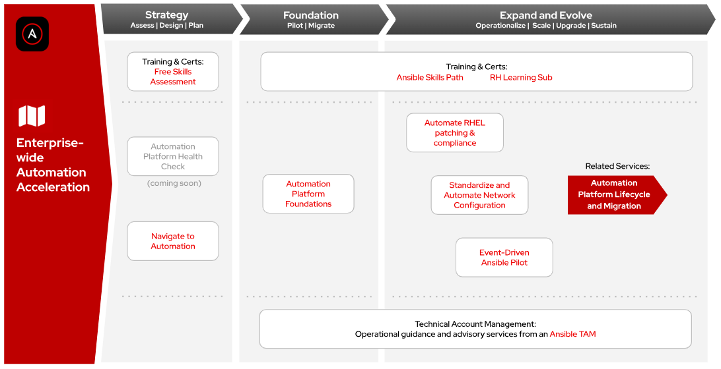
Related Solutions
Red Hat Infrastructure Standard Adoption Model
That may be relevant to your Client
Identity Management Pilot
Standard Operating Environment Provisioning for RHEL
Ansible Automation Platform FastStart
Automate RHEL Patching and Compliance
Ansible Automation Adoption Journey
RHEL in-place upgrade at scale with Ansible
Convert to RHEL from CentOS and Oracle Linux
many more …
WARNING: the picture of the map is static while the map itself is dynamic and can change over time. see hub for latest. last updated 9/8/23
Notes:
[Content Owner]: Paul Armstrong

Slide 23
Implementer Resources - Details
Red Hat Infrastructure Standard Adoption Model
This is relevant to the service delivery team.
Framework Navigation and Mind Map (Miro board)
Framework Navigation Presentation
rhis-builder Presentation
WARNING: the picture of the map is static while the map itself is dynamic and can change over time. see hub for latest. last updated 9/8/23
Notes:
[Content Owner]: Paul Armstrong

Slide 24
Product Overview
Note: This section is not meant to replace the product content on Content Center but rather be a quick reference guide for some VERY high level information.
Please use the Content Center for deep dive into the product and its capabilities.
Red Hat Infrastructure Standard Adoption Model (2023) - AE Deck
Red Hat Enterprise Linux Red Hat Satellite Red Hat Ansible Automation Platform Red Hat Identity Management Red Hat Hybrid Cloud Console
Notes:
[Content Owner]: Paul Armstrong
Using bullet points, describe what this offering/solution is in simple terms

Slide 25

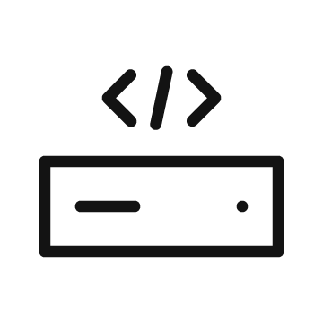



One platform. Unlimited potential.
Red Hat Infrastructure Standard Adoption Model
Red Hat Enterprise Linux simplifies operations across the enterprise
Without standardized infrastructure
With the Red Hat Infrastructure Standard
IT Operations Lead
Inconsistent experience and management complexity
IT is a center of innovation that is productive, secure and efficient
Enterprise Architect
Lack of choice of applications, hardware, and cloud technologies
Consistent and repeatable experience across environments
System Administrator
Unable to maintain control and focus on critical initiatives.
Automated administration of critical infrastructure
Developer
Lack of consistency and multiple build environments
Consistent application packaging, tooling, portability, and security
Notes:
[Content Owner]: Paul Armstrong
(1 minute) Red Hat Enterprise Linux Solutions to Individuals Challenges
With Red Hat Enterprise Linux, your business can access a platform with unlimited potential that will reduce friction across IT teams and help meet the demands of your business stakeholders.
This platform provides a consistent and repeatable experience across physical, virtual, private cloud, public cloud, and edge, allowing your IT Operations Lead manage a streamlined and efficient environment.
Enterprise Architects will also benefit from the freedom and flexibility with longer life cycles, and robust ecosystem of certified hardware, software, and cloud partners. They’ll benefit from this because they be able to work towards building out consistent and repeatable environments.
Meanwhile, your System Administrator can build out automated administration of critical infrastructure with scalability and portability on-premise or in the cloud which will allow them to spend more time focusing on critical initiatives
Developers can leverage containers and consistent application packaging, portability, and security to deliver applications faster.
No matter what your next digital transformation entails, Red Hat Enterprise Linux will be there to support your goals.

Slide 26
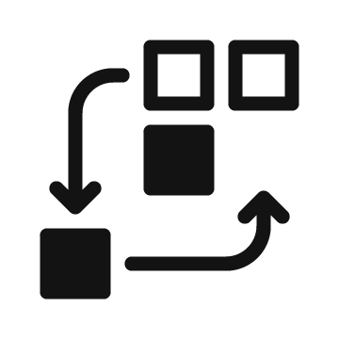



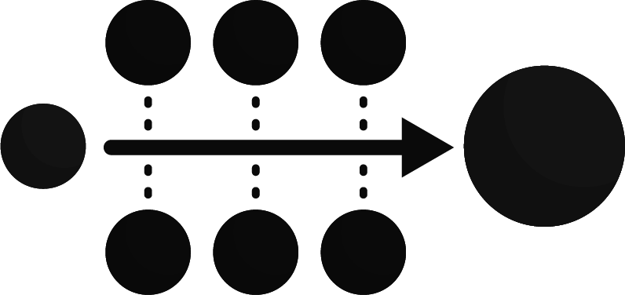

Satellite for Red Hat Enterprise Linux
Red Hat Infrastructure Standard Adoption Model
Create the foundation for Standardization
Overcome scale, skill, and security gaps
Patch
Provision
Report
Control
Identify & Remediate
*Source: Satellite IDC Business Value Whitepaper
Notes:
[Content Owner]: Paul Armstrong
Satellite for RHEL combines the capabilities of Satellite with the simplicity of management from the cloud and helps to improve overall operational efficiency by 28%.
Red Hat Satellite helps to patch, provision, report, and control your RHEL hosts and paired with Red Hat Insights, Satellite helps to to both identify issues via cloud.redhat.com and remediate them. We’ll talk more about this later as we move into what’s new with Satellite.

Slide 27











Ansible Automation Platform
Red Hat Infrastructure Standard Adoption Model
Break down the silos.
Unified platform
Governance
Consistent automation
Cloud
Edge
Data center
Line of business
Devs/DevOps
IT ops
SecOps
Network ops
Notes:
[Content Owner]: Paul Armstrong
IT automation can bring the necessary change to tackle these challenges by...
integrating the different tools within siloed domains
streamlining processes across the tools
breaking down the silos between teams, integrating the various tools and processes across teams
establishing consistent governance of processes, products, and technologies
offering clear interfaces to provide and to consume resources as part of the automation
providing clear means to implement new processes and new content to extend the automation it self

Slide 28






Identity Management in Red Hat Enterprise Linux
Red Hat Infrastructure Standard Adoption Model
Centralize identity management, enforce security controls, and comply with security standards
Centralize
Manage identities and enforce authentication policies from a centralized location to ensure consistency across all platforms and footprints, improve the user experience, and ease IT burden.
Secure
Configure access requirements and customize permissions to enforce security controls based on the principle of least-privilege, ensuring the right people have the right access at the right time.
Comply
Implement compliance best practices and standards with an independently certified solution that supports your overall identity management strategy.
Live demo
Notes:
[Content Owner]: Paul Armstrong
Identity Management in RHEL - Centralize identity management, enforce security controls, and comply with security standards.
Centralize
Applies business policy for centralized enforcement
Provides centralized identity store to ensure efficient authentication and a single source of truth
Ensures that authentication occurs wherever you are for a better user experience
Works across the footprints and platforms for easy deployment on new systems
Secure
Enforces the principle of least-privilege using configurable access control and role-based permissions
Supports multiple authentication types such as two-factor authentication, SSO integration, certificate authority, and more
Delivers the right protocols for the right authentication types to ensure secure user and service access
Comply
Provides a certified solution that is independently validated to ensure compliance
Tracks user activity with audit logs and session recording for security event and incident response
Enables you to implement best practices and standards to support your compliance strategy

Slide 29
Related Products
Red Hat Infrastructure Standard Adoption Model
These all either have their Services Solution Page on the Portfolio Hub, a related Scoping Option for this solution, or a backlog item to create a Solution or Scoping Option.
Identity Management Pilot
Standard Operating Environment Provisioning for RHEL
Ansible Automation Platform FastStart
Automate RHEL Patching and Compliance
Ansible Automation Adoption Journey
RHEL in-place upgrade at scale with Ansible
Convert to RHEL from CentOS and Oracle Linux
many more …
Notes:
[Content Owner]: Paul Armstrong

Slide 30
Top requested capabilities of Red Hat Infrastructure
Red Hat Infrastructure Standard Adoption Model
Things we have heard…
“Integrate my RHEL systems deployment on-premise seamlessly with Azure.”
“You have told me you can build and run RHEL systems the same anywhere. Show me!”
“Help me automate my traditional infrastructure the same way you helped me with containers.”
“I need to build compliant systems at scale, maintain them and attest to it. Can you help?”
“Can you help me automate my systems maintenance. I can’t innovate while keeping the lights on.”
Notes:
[Content Owner]: Paul Armstrong
Using bullet points, describe the top requested capabilities of this offering/solution in simple terms
Utilize footnotes if needed, otherwise delete

Slide 31
Appendix

Slide 32
Contributing:
Editing - Please add your edits/comments to the main deck located here:
https://docs.google.com/presentation/d/1HGPE-Wod7XO9WRCCnnga3Qy3mcoifyusVlRaRAu_Pak
This is a shortened version of the main deck for customer overview presentations. It will be periodically updated.
Notes:
[Content Owner]: Paul Armstrong, Mike Savage

Slide 33
Contributing:
Editing - please add slides that you would like to see to the deck. If they need a section, add the section separator slide. Tag your slide in the content notes section with:
[Content Owner]: <Your Name>
This helps in collaborating with others. There are lots of editors :-)
You are responsible for maintaining your content in this deck. Please only edit your own content.
If you need to make changes for a customer presentation, please make a copy to your own drive.
Notes:
[Content Owner]: Paul Armstrong

Slide 34
Contributors & Reviewers
These folks had a hand in creating and/or reviewing this content.
Contributors
Paul Armstrong <parmstro@redhat.com> - Principal Technical Specialist - RoOT Canada - Oct 2023
Kristin Hendricks <krhendri@redhat.com> - Senior Program Manager - Global Services - Oct 2023
Mike Savage <msavage@redhat.com> - Chief Architect - CTO Org: Customer-led Open Innovation - Nov 2023
Jerone Young <jyoung@redhat.com> - Senior Architect - Consulting Services - Nov 2023
Martijn ten Heuvel <mtenheuv@redhat.com> - Senior Architect - Consulting Services, Netherlands - Nov 2023
Reviewers
Notes:
[Content Owner]: Paul Armstrong

Slide 35
Source
This deck was based on the following template, if wanting/needing to make a deck like this of your own we encourage you to clone the template:
TEMPLATE replace with name of offering/solution | Services Seller Enablement [v2.0 - Current]

